Slide 1



Project Overview and Development of the Database
Dr Laura O’Connor (BSc, PhD, FHEA), Principle Investigator, HIQA
26 February 2021

Slide 2

EU Commission and Open Data
EU Open Data Directive (2019)
Main points
  should share data in so far as possible
  collect data in a manner that it is suitable (interoperable, analyzable) for re-use
Aim
Stimulate publishing of data for re-use and strengthen transparency in public sector bodies
HIQA fulfils the legislative requirements through publishing inspection reports
HIQA Corporate Plan 2019-2021: Vision – provide advice, evidence and information to inform local and national decisions about services
Notes:
In 2019 the EU Commission published the EU Open Data Directive. This replaced the Public Sector Information Directive (2003).
HIQA fulfills its legislative requirements relating to statutory notifications through publishing inspection reports which contain information on notifications received. However in 2019 as part of HIQA’s corporate plan, we had a vision statement which read – we will provide evidence and information to inform local and national decisions about services. As such, we thought we could do more against this Directive in relation to the notifications data that we receive.

Slide 3
Need for Open Data
The amount of data created each year is growing faster than ever before.
Evidence based decision making - puts the best available evidence from research at the heart of policy development, programme management and project implementation
Lack of data access:
Barrier to analyses and broader research - stifles the potential to inform policy and evidence based practice
Limits data linkage and analyses of data from different perspectives – limits new insights and innovation
Notes:
The amount of data is growing faster than ever before, each of us generate about 1.7 megabytes of information each second. However,
I don’t think anyone would disagree with me if I said there is a need for data and health information. But I would purpose that we don’t have a need for more data, we have a need for better data access. We need data to underpin evidence based decision making. Evidence based decision making is about putting the best available evidence from research at the heart of policy development, programme management and project implementation. Lack of data access is a barrier to analyses and research.

Slide 4
FAIR Data
Findable – visible, online
Accessible – formats, not behind pay walls, not needing complex data agreements
Interoperable – similar variables collected and represented in same way across datasets
Re-useable - Collect data in a manner suited to needs and analyses
F – findable
A – accessible
I – interoperable
R – reusable
Notes:
That said, it is not enough to have open data, it also needs to be FAIR data. FAIR stands for findable, accessible, interoperable and reusable. Findable is about being stored in a place where people can find it, maybe this is online. It is also about the data being visible, as in people should know it is there and it not be sequestered away in the dark corners of the web. Accessible is about having easily downloadable formats, formats that work in different software, not having barriers to access such as pay walls or complex data sharing agreements. Interoperable is about how data are collected and represented, ensuring similar variables or data elements are represented in the same way so that one dataset can speak to another or can be linked appropriately. And, re-usable, this is about ensuring data can be used for broader related purposes. Think of the difference between trying to reuse text from a word document versus from a pdf.

Slide 5
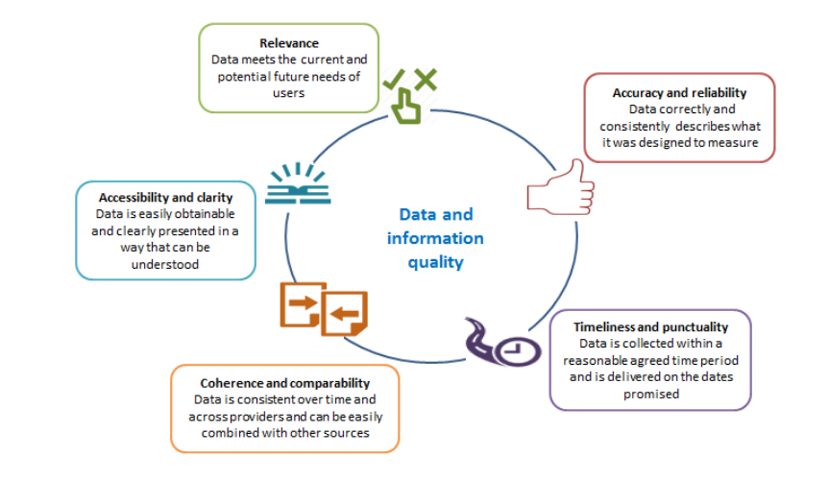
Data Quality Dimensions
Notes:
Having the data and making it open and fair is still not quiet enough. We also need to ensure that the data are quality data. Although there is some overlap with the elements of fair data, there are 5 established dimensions of data quality. These are - relevance (ensuring that the data meet the needs of users), accurate and reliable (correct), timeliness and punctuality (collected in a timely manner and delivered/updated when promised), coherent and comparable (consistent over time and across providers and can be easily combined with other sources) and, lastly, accessible and clear (easy to obtain and clearly presented in a way that it can be understood).

Slide 6
HRB Secondary Analyses Grant
2019 Grant call:
Bring together researchers, data controllers and knowledge users to use secondary analyses of data to answer policy and practice questions relevant to the Irish health and social care system.
Make use of an existing Irish or international dataset.
HIQA – national data collection of statutory notifications from designated centres
Notes:
Against this backdrop of an acknowledged need for open, quality data, particularly in the space of health information and health and social care services research - in 2019 the HRB announced a grant call,
The grant call had a condition that any proposals must make use of an existing Irish or international dataset. HIQA do host a national data collection of statutory notifications from designated centres for older persons and people with disabilities.

Slide 7
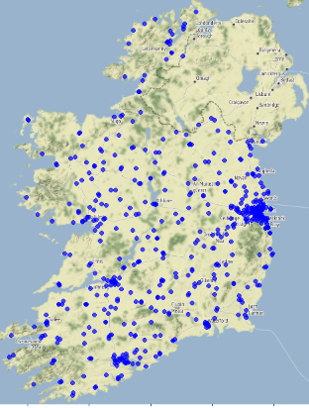
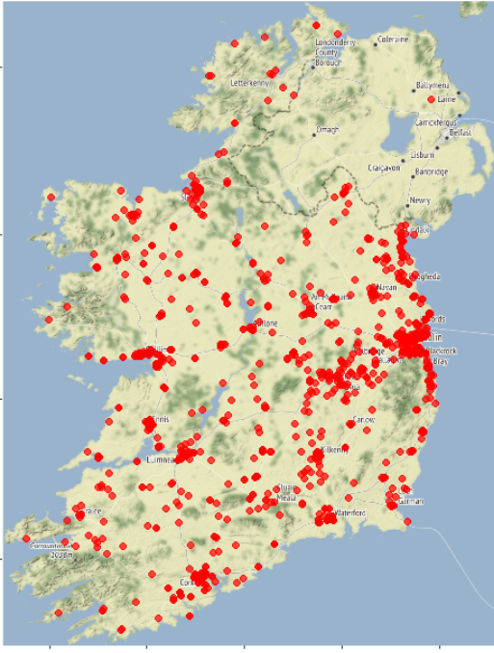
Designated centres in Ireland
600 centres for older persons (32,000 people)
1300 centres for people with disabilities (9000 people)
Health Act 2007
Regulation and receipt of notifications
Centres for older persons commenced in 2009
Centres for people with disabilities commenced in 2013
Electronic system for submission of notifications (PRISM) - 2013
Submitted 30,000 notifications in 2019
Centres for older persons
Centres for people with disabilities
Notes:
There are the 600 centres for older persons and 1300 centres for people with disabilities in Ireland. These cater for 32000 and 9000 residents respectively. Notification to the Chief Inspector of certain incidents and events are mandated under the Health Act. Centres have been submitting notifications since regulation was introduced in 2009 for older persons and 2013 for disabilities. In 2013 an electronic system for managing notifications known as PRISM was introduced. An enormous number of notifications are processed through this system on a daily basis. By way of example, in 2019 close to 30,000 notifications were received.

Slide 8
Notifications
Unexpected death
Infectious disease
Allegations of abuse
Serious Injury
Staff misconduct
Staff under review
Unexplained absence
Unplanned evacuation
Use of restraint
Fire alarm activation
Theft
Pressure Sores/other injury
Other death
3 day notifications
Quarterly notifications
Event
Notifications submitted
Inspector Review
Risk Rated
Inform monitoring approach
Notes:
There are two different categories of notifications 3 day and quarterly. Notifications cover a range of incidents and events including.
There is a wealth of information in these notifications to answer practice and policy questions.

Slide 9
LENS Project
LEarning from Statutory Notifications in Social Care
Aim To use the information within statutory notifications to:
support service providers and inspectors on the front line when dealing with adverse events,
improve reporting and processing practices,
inform existing and emerging policy and regulation,
and ultimately to improve the quality and the safety of the residential services received by older people and people with disabilities in Ireland and internationally.
Notes:
As such, we applied to the HRB for the secondary analyses grant. The HRB awarded us €250,000 to develop the database and undertake secondary analyses of the notifications. The project is known as the LENS Project which comes from - learning from statutory notifications in social care.

Slide 10
LENS Project
Work packages
  Database development
  Descriptives and determinants
  Good practice and avoiding harm
  Lexicon development
  Prioritisation of notifications
Notes:
This is a three year project which commenced in April 2020. There are 5 work packages in the project, Firstly the development of an analyzable database and tools to support analyses and this is the work package we are sharing today. The other work packages are at various stages of completion and I will touch on each of them briefly in this presentation.

Slide 11

Development of the Database
2013-2019
Cleaned, recoded, categorised, geo-mapped, calculated new variables, linked to demographic and structural information about centres
Convened panels with end users to inform database inclusion
Developed a data quality framework against the national standards for information management for health and social care data collections
Developed tools to support interpretation and use
Notes:
In developing the database we started the data extraction in 2013 corresponding with the introduction of PRISM and went as far as the end of the last complete year – 2019. We cleaned, recoded, categorized, geo-maped, linked notifications data and centre data. We convened panels with potential end users to inform inclusions. We developed a Data quality framework in line with the national standards.
We developed tools to support interpretation and use which Paul will take you through in the next presentation.

Slide 12

The Database of Statutory Notification from Social Care in Ireland
407 variables, 125,724 lines of data
Structure, unstructured and semi-structured data
No redactions, pseudonymised
Contains all the detail contained in notifications and linked to centres.
Benefits
National perspective
Compare groups and characteristics
Greater statistical power
Identify trends not observable when looking at a single notification or centre
Notes:
The resulting database includes 407 variables, 125,724 lines of data, each an individual notification. This database is held internal to HIQA and is the basis for the open access database published today. There are no redactions in this, however it has been pseudonymised meaning, a person or a centre cannot be identified directly but there is a key (held securely) if we needed to work backwards from some reason. The database contains all the detail contained in notifications and linked to centres. This is nothing new in a way, as HIQA staff we can see the individual notifications and centre details and have all the appropriate confidentiality agreements in place. What is different is that we can now view this information from a national perspective, examine trends and compare groups. Bringing all the information together also provides more statistical power so that we can be more confident in our findings. Examining a large dataset can give different insight than can be gained from evaluating individual notifications or notifications from an individual centre. It facilitates for example, analyses based on, nursing home type, eg large urban, small rural.

Slide 13

The Database of Statutory Notification from Social Care in Ireland (Open Access)
Notification type
Notification subtype
When received
Time of event
Risk rating (impact*likelihood)
Number of residents involved
Medical treatment required
Length of stay in hospital
Care plan updated
Restraint use
Evacuation plan effective
2013-2019
130 variables
125,724 lines of data
Provider type
Bed numbers
Distance to hospital
Disability type catered for
Staff:Resident ratios
Notes:
Today we have published an open access version of this database. As I have said, it is based on the internal database. It contains the same number of notifications however some variables have been redacted and I will explain that next. The Open access database contains centre information and information on notifications.

Slide 14
Desensitisation and anonymisation
Aim – prevent identification of a centre or a resident
Risk rated variables for the potential to identify a resident
Isolation or in combination with other data
Removed centre names and identifiers
Collapsed variables, such as bed numbers, into ranges
Removed free text where it couldn’t be cleaned or categorized
Redacted notifications of staff under professional review
Notes:
In preparing the open access database, to protect the privacy of residents and to ensure centres cannot be identified we undertook a desensitisation and anonymisation step. We risk rated all the variables for the potential to identify an individual either by using the variable alone or by combining it with another variable in the database or with other data published elsewhere. We removed centre names and identifiers, collapsed variables such as bed numbers into ranges, removed free text and redacted notifications of staff under review as these are published in detail by other organisations and cross referencing could lead to identification of an individual. The notification is still included but there is very limited data is provided.

Slide 15
GDPR
Applies to the collection and processing of personal data
Notifications are not personal data, they are about an event not a person
They may contain personally identifiable data
Open access version – cleaned, desensitised and annoymised
The Seven Principles
Lawfulness, fairness and transparency
Purpose limitation
Data minimisation
Accuracy
Storage limitation
Integrity and confidentiality (security)
Accountability
Notes:
Before I move on to briefly describe the other work packages within the LENS Project, I would like to touch on GDPR as this is something we’re often asked. GDPR applies to personal data. Notifications are not personal data per se, they are about an event not a person. However they may contain personal information but the data that are being published today do not. The dataset has been carefully cleaned and annonymised.
There are 7 principles to GDPR, the one of concern here is the principle of purpose. This is about using data for the reason it was collected and not another reason. The reason notifications data are collected is to inform the monitoring of services and the provision of safe quality care in services. This is the same purpose any analyses of the database would have, it is just examining the data from a different perspective.

Slide 16

Current projects
Quality Log - informing data collection processes
National statistics and trends – Dr Stephanie O’Regan
Current practice in the aftermath of notifiable events – Dr Niall McGrane
Public and patient involvement
Notes:
This brings me to the other work packages within the LENS project. Those working on the development of the database are in a somewhat unique position in that they have had sight of all the data simultaneous for sometime now, they have been compiling a quality log, tracking errors, noting areas needing improved data collection and compiling suggestions for data collection that would simplify analytics. This is being fed back into the system and informing quality improvements. It’s a benefit of have a research team working alongside the knowledge users.
We also have two analytical projects nearing completion one on quantatative analyses being led by Stephanie and one qualitative thematic analyses being led by Niall, both will present on these after the break. We are also beginning a piece of work to involve residents in this project, asking people living in residential care their thoughts on the analyses we should be doing and on the format of the outputs that would be most useful for them.

Slide 17
Next projects
Lexicon - standardised language for use when submitting notifications
Risk prioritisation of notifications - identifying which notifications lead to the largest changes in risk rating of centres
Root cause analyses - identifying common contributing factors to the occurrence of adverse events
Structural and organisational determinants of notifications
Notes:
In terms of work to come, we intend to develop a lexicon for notifications. We are aware that within notifications many different terms are used when referring to the same thing. This can lead to communication barriers between services and inspectors. It also makes it difficult to run analyses on the collection of notifications and as such limits the potential for learning. Standardised terminology will improve both of these issues. We will use the language used in notifications to extract frequently used terms and develop recommendations for a single term for each.
As you will have seen, we receive a very large number of notifications every day. Notifications can lead to a change in the risk rating of a centre and thus highlight an area/centre of concern. We want to examine notification types to identify which ones are more likely to lead to a change in risk rating thus allowing us to prioritize their review. It may be that some notifications that we receive at the end of a quarter are more urgent and we should receive them sooner. Or possibly some notifications that are mandated to be submitted within 3 days of an event are less urgent and could be submitted less frequently. We are also going to complete a root cause analyses of a sample of notifications to identify common contributing factors to the occurrence of adverse events to support the development of quality improvement initiatives. And lastly we will examine structural and organizational determinants of notifications to support the development of policy and planning for care services.

Slide 18
Conclusion
Statutory notifications data present an opportunity to undertake analyses of incidents relating to safety and welfare of people living in designated centres.
The database has been made available for secondary analyses and to maximise the potential of the data, facilitate new learnings and stimulate innovation.
Notes:
In conclusion, statutory…. As such, I encourage people to use it. The team are happy to support or collaborate on analyses. I’m conscious that we have a number of international colleagues with us today from other regulatory bodies who may also like to publish their notifications data. All the detailed steps we have taken in developing, cleaning, desensitizing and publishing this database are being written up for publication at the moment. We hope this will act as a roadmap for others if considering publishing their data.

Slide 19
With thanks
Funded by the HRB SDAP award. SDAP-2019-005
Co-funded and hosted by the Health Information and Quality Authority
Collaborators/Board Members: Mary Dunnion, Carol Grogan, Máirín Ryan, Conor Foley, Margaret Cahill, Ian Leistikow, Kevin O’Carrol, Kevin Roantree, Rachel Flynn
Team: Paul Dunbar, Dr Niall McGrane and Dr Stephanie O’Regan

