Slide 1
Accessing and using the database
Paul Dunbar, Senior Researcher, HIQA

Slide 2
Introduction
In this short presentation I will outline:
How to access the database through Tableau Public
What tools are available to support the use of the database
What updates will be made available

Slide 3
Tableau Public
We have chosen to use the online platform Tableau Public for
hosting the open database online
This allows is to create a user-friendly interface with
data visualizations
Some of the interface is interactive and users will be able to get a quick overview of the data

Slide 4
Notification codes
3-Day
NF01 - Unexpected Death
NF02 - Disease Outbreak
NF03 - Serious Injury
NF05 - Unexplained Absence
NF06 - Abuse
NF07 - Misconduct
NF08 - Professional Review
NF09 - Fire or Loss of water/power/heat
Quarterly
NF39 - Quarterly Notification
NF39A - Restraint Use
NF39B - Fire Alarm Activation
NF39C - Theft/Burglary
NF39D - Minor Injury (Disability)
NF39D - Death (Nursing Home)
NF39E - Death (Disability)
NF39E - Pressure Sore (Nursing Home)
Notes:
Codes link to specific variables

Slide 5
Accessing the database
You can find the link to Tableau and a link to the full Excel file here:
https://www.hiqa.ie/areas-we-work/Database-of-Statutory-Notifications
The Tableau homepage shows an overview of the data in a bubble chart. There is also a list of the types of notification for reference.
You can use tabs to navigate to data for each type of notification. You can download the data within a tab where you see the download symbol.
Live demo

Slide 6
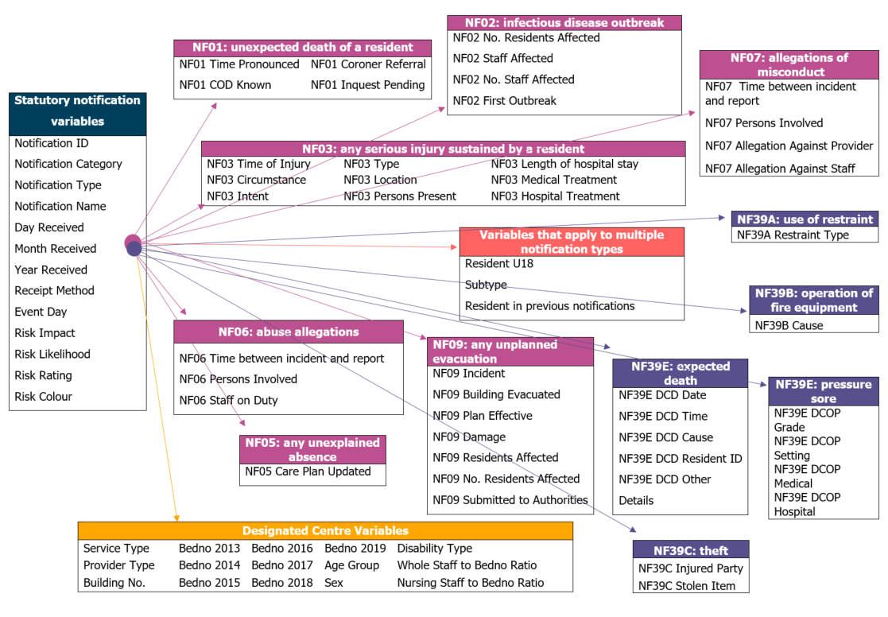
Tools
We have developed a range of tools to help
people understand and interpret the data
Data Quality Statement
Data dictionary
Data map
E-learning module
These are all available on the HIQA website, under ‘Areas we work in’ or https://www.hiqa.ie/areas-we-work/Database-of-Statutory-Notifications

Slide 7
Database updates
The data available today covers 2013-2019
Additional data will be made available on a yearly basis
We will download, clean and recode data after the first quarter of every year
Data for 2020 will include specific notifications for COVID-19 under the outbreak of disease notification

Slide 8
Thank You

